Slide 1

AI-Driven Movie Recommendation System
Objective
Our primary goal is to create an intelligent system that suggests movies to users based on their unique preferences and past ratings.
This system aims to enhance user experience by curating a list of movies tailored to individual tastes, leveraging advanced AI algorithms.
The Need for Personalization:
In an era where streaming services offer an overwhelming number of choices, personalization is key to user satisfaction.
Our AI model will not only streamline the movie selection process but also discover hidden gems and new favorites for our users.

Slide 2
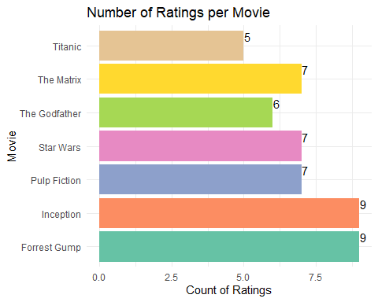
User Engagement per Movie
The dataset comprises 22 users and 7 movies and ratings.
Forrest Gump and "Inception" lead with 9 users each having rated them.
"Pulp Fiction, "Star Wars," and "The Matrix" have been rated by 7 users.
"The Godfather" follows with 6 users, and "Titanic" has been rated by 5 user

Slide 3
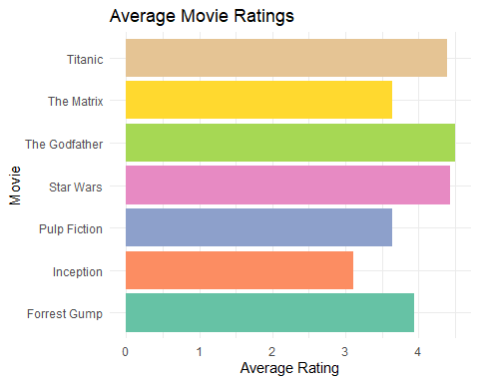
Movie Rating Insights
The average ratings are indicative of how well-received each movie is among viewers.
Movies with higher average ratings, such as "The Godfather" and "Star Wars", are typically more favored and possibly resonate more with a broader audience.
We also observed variability in how different movies are rated. For instance, "Inception" shows a lower average rating, suggesting more diverse opinions among viewers.

Slide 4
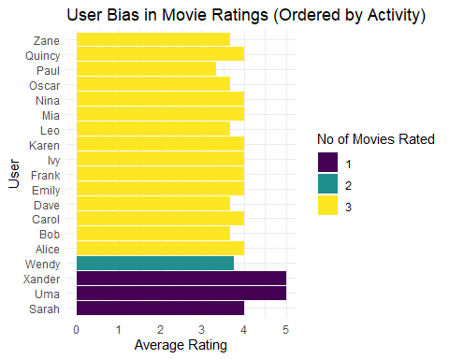
User Behavior and Bias
Our findings show a range of rating behaviors among users. For instance:
Users like Alice, Carol, and Emily rated three movies, each with an average rating of 4, indicating a tendency towards favorable ratings.
Conversely, a user like Paul, with an average rating of 3.33 for three movies, appears more critical in their assessments.
These patterns are crucial in understanding individual user preferences and biases.

Slide 5

Towards a Predictive AI Model
Innovating with AI and Machine Learning:
Our proposed AI model will utilize sophisticated algorithms such as collaborative filtering.
Collaborative filtering taps into user rating patterns to predict and suggest movies that similar users have enjoyed, offering a personalized experience.
Leveraging User Data for Tailored Recommendations:
The AI system will analyze user preferences, rating tendencies, and viewing habits intricately.
This approach ensures that each recommendation reflects not just popular choices but a curated selection tailored to individual tastes.
Future Developments and Enhancements:
We envision a dynamic model that continually learns and evolves based on user interactions, enhancing its accuracy over time.
Future enhancements may include integrating more complex variables like user demographics, viewing contexts, and temporal patterns.

